Slide 1

SD CARD INTERFACE WITH FPGA ON MULTIMEDIA APPLICATIONS
MEMBERS :
SAKTHEKANNAN M S(212219060228)
UDAYA KRISHNAN M (212219060284)
YOGAVIGNES BM(212219060302)
GUIDE: Dr. Srigitha S Nath

Slide 2
ABSTRACT
Based on FPGA (Field Programming Gate Array) chips, this application is used for audio and image processing. At the same time, applications require more memory in addition to on-chip memory to resolve additional data. Onboard memory can be used to meet the requirements of FPGA systems but cannot be expanded by adding just a few cards. More convenient is SD card (Secure Digitals) which can read and write to SD card. The main goal is to provide a storage solution for FPGA, a low-cost, removable, non-volatile, flash memory, portable and easy-to-use storage solution for FPGA for storing large files. The hardware design is done in Verilog HDL language and implemented in FPGA. All data access from the SD card is through Verilog, eliminating the need for an on-chip microcontroller or general-purpose processor.

Slide 3
OBJECTIVE
The main goal of SD(Secure Digitals) card is to provide a storage.
SD card is a low-cost, removable, non-volatile, flash memory, portable and easy-to-use storage solution for FPGA for storing large files. The hardware design is done in Verilog HDL language and implemented in FPGA.
All data access from the SD card is through Verilog HDL, eliminating the need for an on-chip microcontroller or general-purpose processor

Slide 4
MOTIVATION BEHIND THIS PROJECT/NOVELTY
When a FPGA memory is almost full containing pictures, videos, documents, files, etc, the memory occupancy in the device (like mobile, laptop, etc) functionality becomes too slow.
In-order to prevent this slow process, we can add a SD card as an external memory.
This SD card can access the files stored in devices by the help of Verilog HDL language, which can be able to read, write, edit, change the files.
To make the transaction of the audio and video files between the devices more efficient and faster.

Slide 5
LITERATURE REVIEW
YEAR | AUTHOR | TITLE | PROS
2020 | Dumitrel Cătălin Costache, Lucian Andrei Perișoară,Adriana Florescu | FPGA Implementation of a SD Card Controller using SPI communication. | Adding number of SD cards involves sharing the same clock and data signals and different chip-select signals for each card.
2011 | Omar Elkeelany | Data Archival to SD Card Via Hardware Description Language. | Real-time design of data archival to the SD card that is used in data concentrator applications for remote sites.
2019 | Gul Munir Ujjan, Abdul Malik, Shakil Ahmed, Mohd Zaid Abdullah | Implementation of 4-Bit Data Transmission for Accessing SD Card with FPGA Embedded Soft Processor. | Read operation with SD 4-bit mode is 67% faster than SD 1-bit mode and write operation in SD 4-bit mode is 80% faster than SD 1-bit mode.
2010 | Zhenlin LU, Jingjiao LI, Yao Zhang | The reading/ writing SD card system based on FPGA. | FPGA system can read and write data on SD card, good to meet the FPGA system needs for external storage devices
Dumitrel Catalin Costache et al(2020) that adding number of SD cards involves sharing the same clock and data signals and different chip-select signals for each card.
Omar Elkeelany et al(2011) that real-time design of data archival to the SD card that is used in data concentrator applications for remote sites.
Gul Munir Ujjan et al(2019) presented that read operation with SD 4-bit mode is 67% faster than SD 1-bit mode and write operation in SD 4-bit mode is 80% faster than SD 1-bit mode.
Zinlin et al(2010) presented the application on FPGA system can read and write data on SD card, good to meet the FPGA system needs for external storage devices. It involves SD card reader that can be applied to variety of FPGA based system.

Slide 6
LITERATURE REVIEW
Dumitrel Catalin Costache et al (2020) that a FPGA controller that allows writing and reading SD cards using the SPI protocol. The SPI transmission mode is a must in order to have a storage system easily scalable. Adding an additional number of SD cards involves sharing the same clock and data signals and different chip-select signals for each card. The proposed architecture involves accessing each card in turn but allows the availability of a large amount of memory.
Omar Elkeelany et al (2011) that a bidirectional hardware-based core for the SD card design was implemented in reconfigurable FPGA based data concentrator chip. Over all a write operation for 5000 blocks can be done in 1 s and the same 5000 blocks can be read from the SD card in 1.051 s. In an earlier work of the authors, the same block size needed 60 s. This difference is mainly due to the use of custom finite state machine design as compared to software-based solutions found in related work. Simulation results show real-time data rates up to 25 Mb/s can be reached. This letter presents a real-time design of data archival to the SD card that can be used in data concentrator applications for remote sites such as in SG. Scalability issues such as the impact of larger size SD cards, and SD cards from various manufacturers will be addressed in future work.

Slide 7
Gul Munir Ujjan et al (2019) presented that A primary hardware system based on FPGA and embedded NIOS-II processor for accessing SD card in 4-bit SD mode is implemented. The software which runs on NIOS-II processor is written in C language using NIOS-II eclipse platform. Using FAT-32 file system, single block read and write commands are implemented and tested. For comparison, these commands are also implemented for SD 1-bit mode. The resulting throughput of read operation with SD-4 bit mode proves it is nearly 67 % faster than SD 1-bit mode. Similarly, for write operation in which SD 4- bit mode is 80 % faster compared to SD 1-bit mode. Throughput can further be improved using multi-block read and write operations and implementing fast mechanism for calculating 16- bit CRC write operation. This requires extra hardware resources and hence additional costs. The proposed firmware will benefit systems which handle big data transfer like real-time video capturing.
Zinlin et al (2010) presented that it gives a brief introduction to the relevant information about the SD card. Then based on FPGA for the SD memory card reader requirements, it designs FPGA-based SD card reader system architecture with the various functional modules for design and development. The system was functional tests. By the test results, you can see that the system can read and write data on SD card, good to meet the FPGA system needs for external storage devices. At the same time, this involved the SD card reader technology that can be applied to a variety of FPGA-based system. Therefore the use of this technology should also have more potential applications.

Slide 8
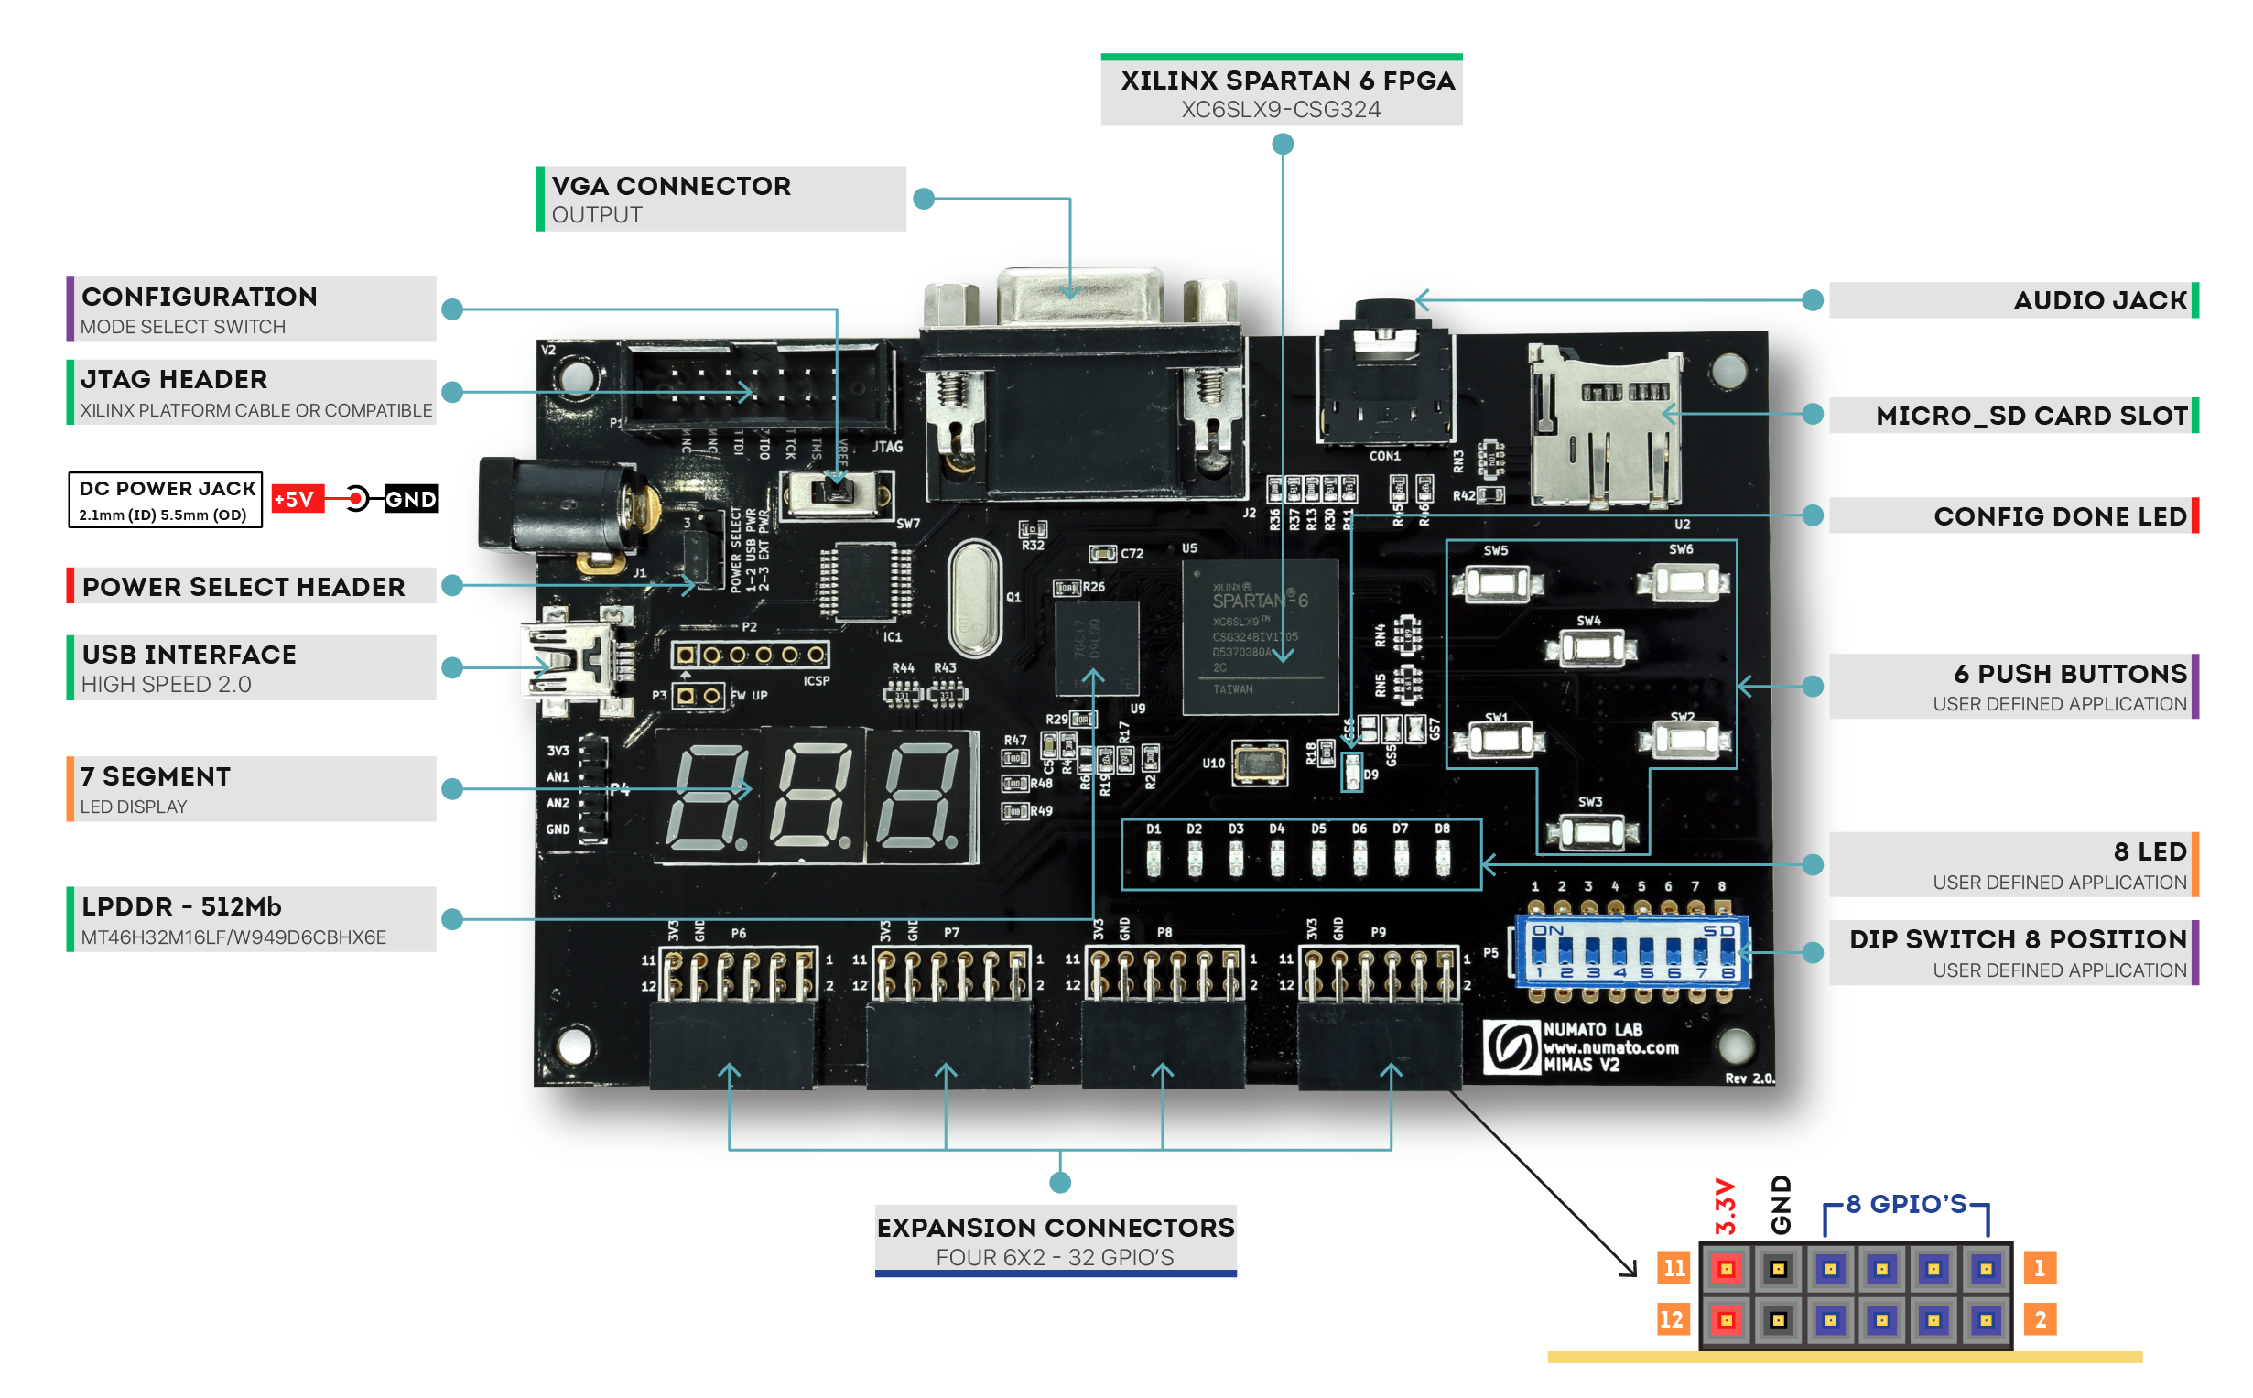
FPGA DEVELOPMENT BOARD

Slide 9
PROPOSED WORK
A general CPU is unable to perform parallel processing, giving FPGA’s the upper hand as they can perform processing and calculation in parallel at faster rate.
FPGA’s can be designed to include multiple blocks processing data in parallel which means it offers much greater scalability as compared to other processors such as ASICs and MCUs.
The memory controller is embedded in SD card. We can access the storage using logical sectors similar to a hard disk drive. It also needs to implement a FAT32 file system.
Maximum clock speed number of regular SD card is 25MHz, which means that 4 MB/s can be only written in 4-bit SD mode. Extra fast cards support clock speeds around 100MHz.

Slide 10
THANK YOU

